Slide 1
ODE-Inspired Network Design for Single Image Super-Resolution Implementation
-Purva Chiniya,EED IIT Roorkee

Slide 2
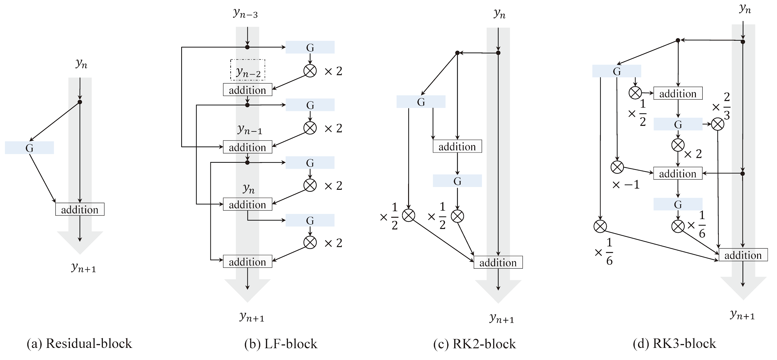
MODEL STRUCTURES

Slide 3

Representative Images:
LR
HR

Slide 4
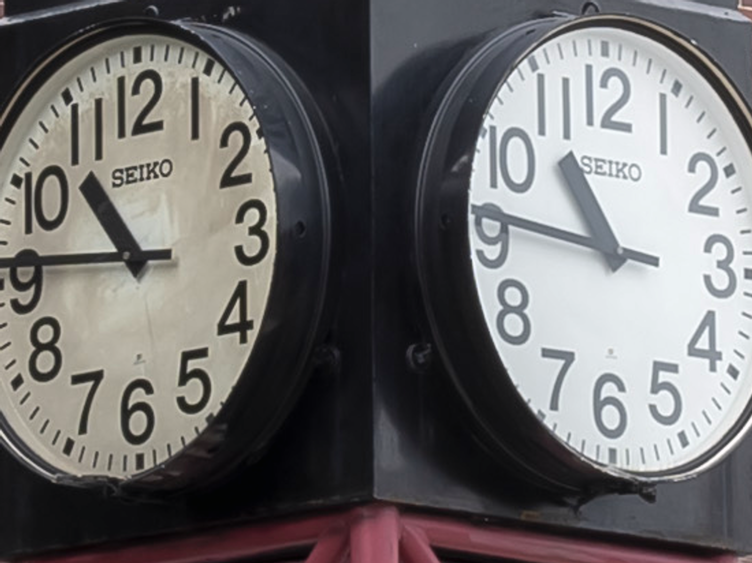
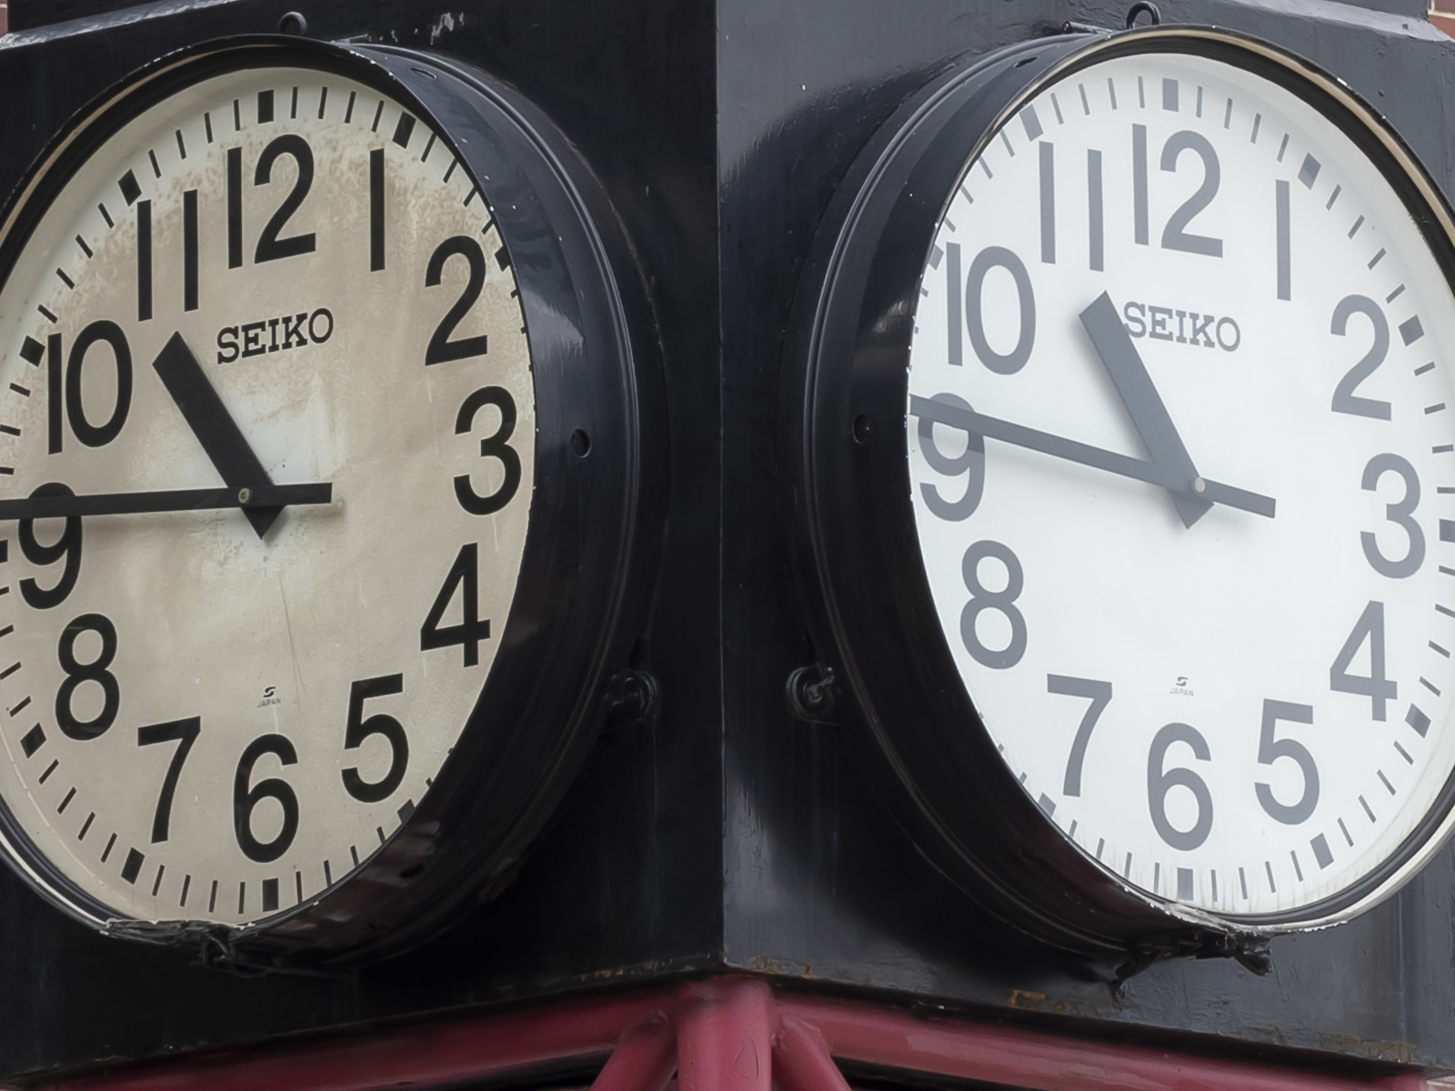
LR IMAGE
HR IMAGE

Slide 5


LR IMAGE
HR IMAGE

Slide 6
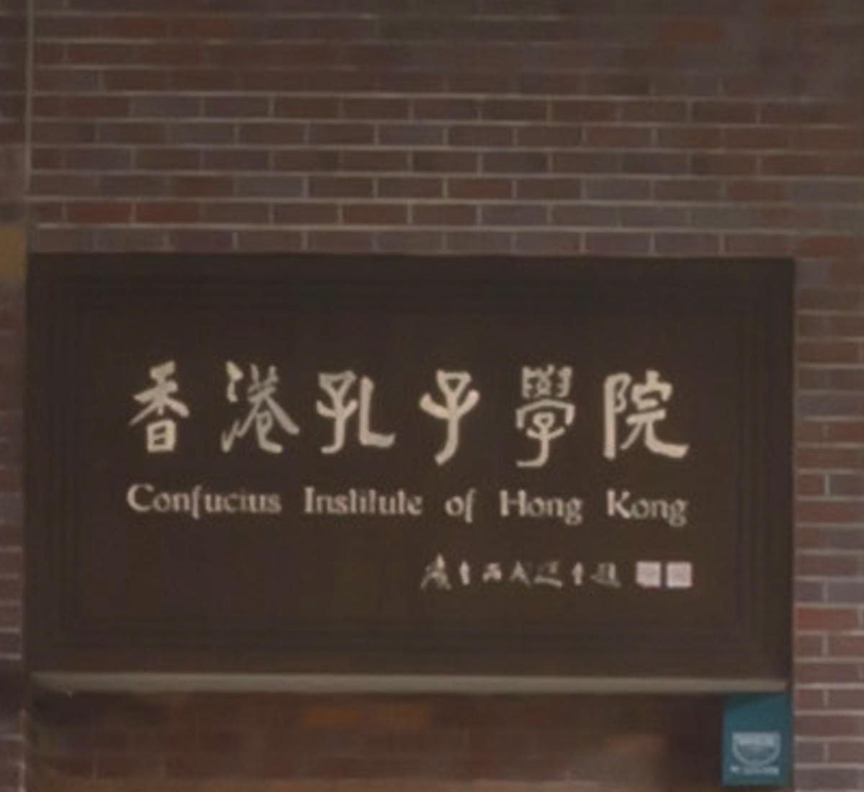
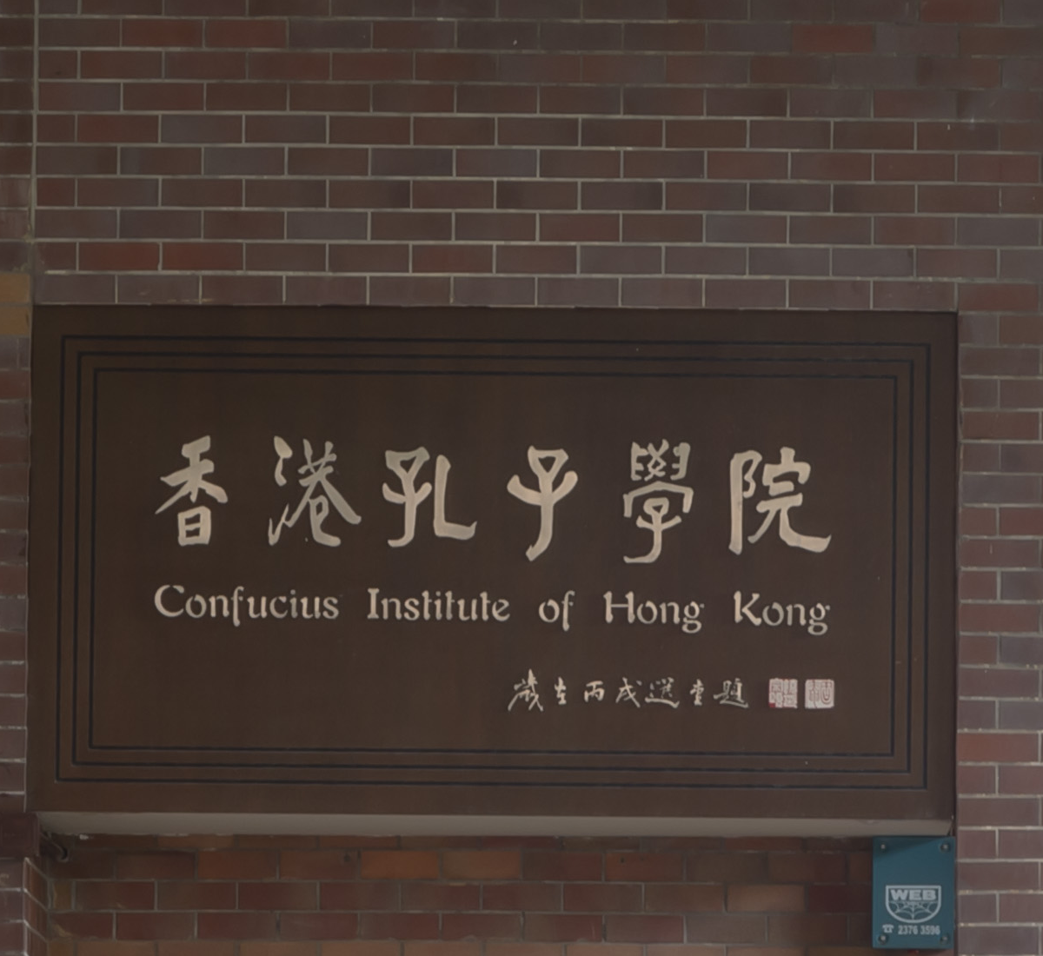
LR IMAGE
HR IMAGE

Slide 7
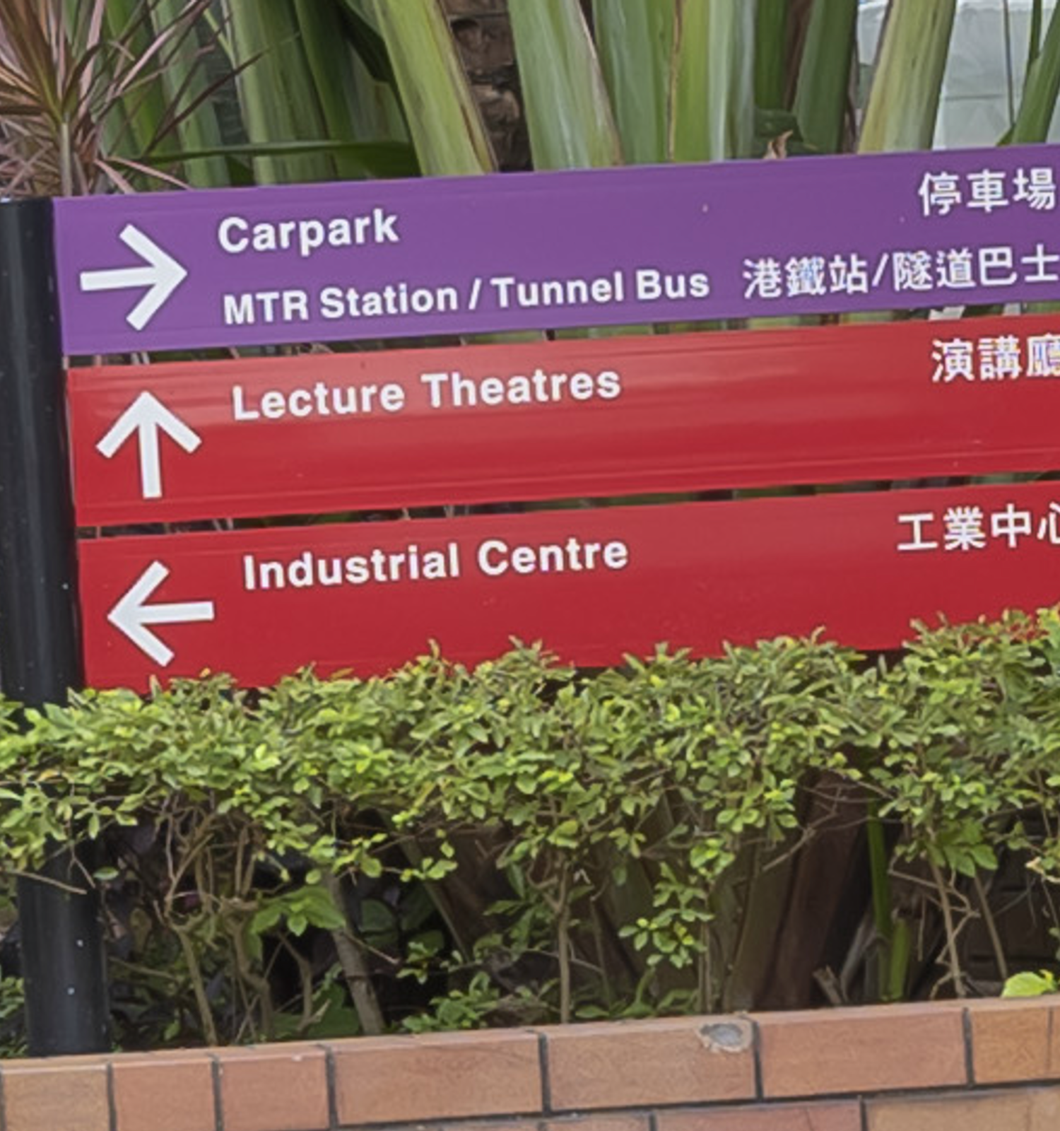
LR IMAGE
HR IMAGE

